Slide 1
Business Analytics Project
Team 7
15146302 Kang, Euiheyon
15146304 Ku, Seunghyo
15146312 Park, Gangmin

Slide 2

CONTENTS
1. Data Collection
2. Data Merging
3. Further Progress

Slide 3
1. Data Collection

Slide 4

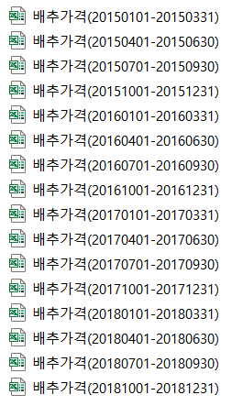
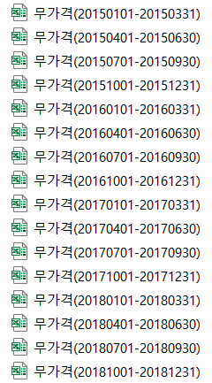
Agricultural Product data
www.kamis.or.kr
This data set consists of the day-to-day, average wholesale price by region, and the average annual price.
Price of cabbage, radish
(2015~2018)
* Average annual price excluding maximum and minimum values in the data for the five-year period based on this year's data

Slide 5

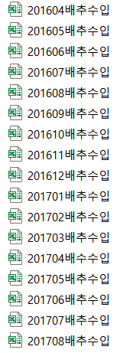
Agricultural Product data
Kati.net
This data set consists of monthly cabbage import volume and import price.
Volume and Price of imported cabbage
(2015 – 2018)

Slide 6


Weather data
Weather.go.kr
This data set consists of
Average Temperature | Lowest Temperature
Highest Temperature | Precipitation
Wind Speed | Dew Point
Relative Humidity | Vapor Pressure
Spot Atmospheric Pressure | Seal-level Pressure
Duration of Bright Sunshine | Solar Radiation Quantity
Maximum Depth of Snow Cover | Maximum Depth of New Snowfall
Amount of Cumulus | Average Temperature of Ground
Total Low Evaporation | Total Large Evaporation
Amount of Middle and Lower Cloud
Weather data
(2015 – 2018)

Slide 7
2. Data Merging

Slide 8
Finding common key
Common key -> Date

Slide 9
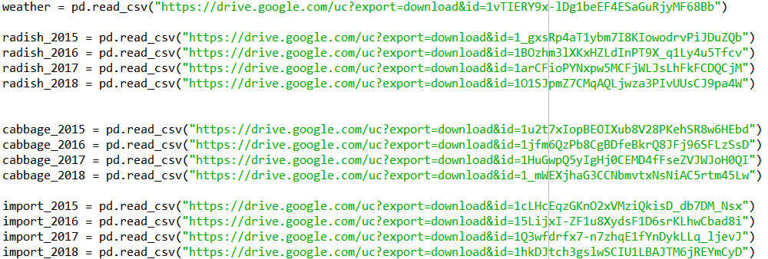
1. Load the datasets (Weather, Radish, Cabbage, Imported Cabbage in 2015-2018)

Slide 10
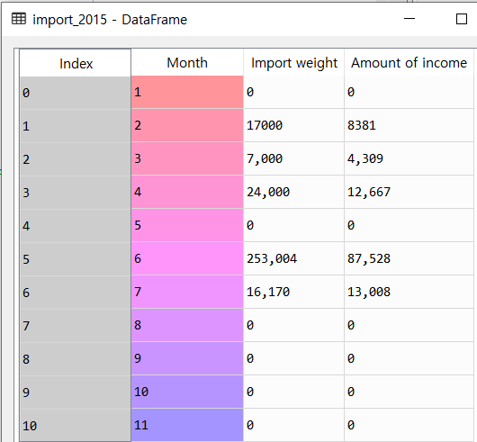
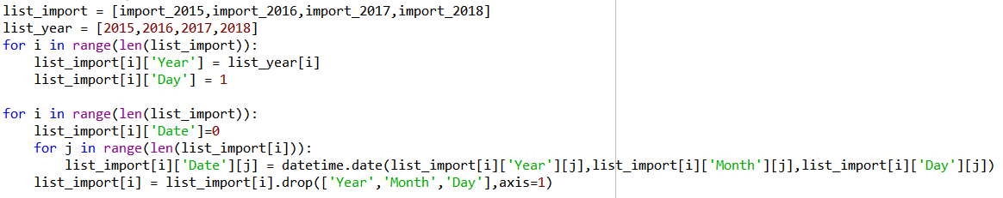
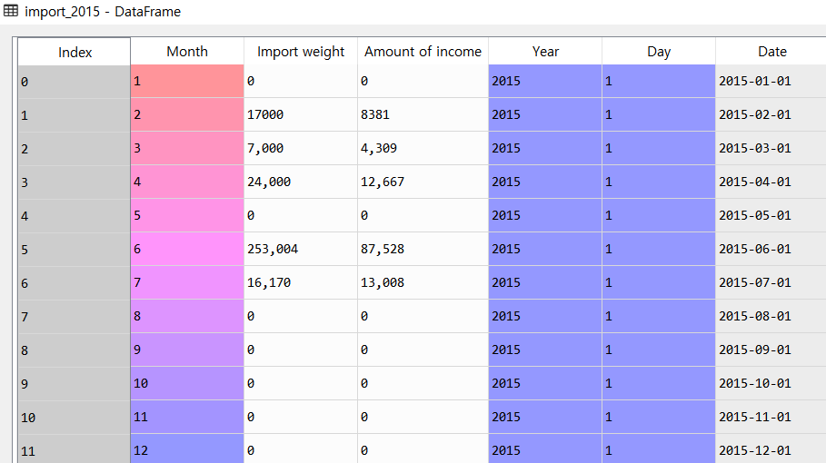
2. Make Date in imported cabbage data

Slide 11
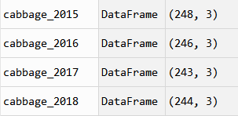
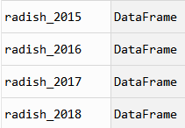
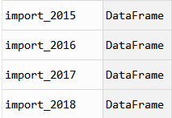



3. Integrate whole year data as one data set

Slide 12
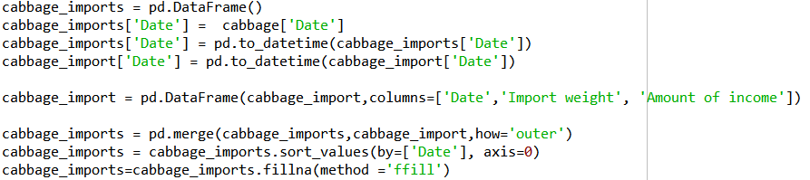
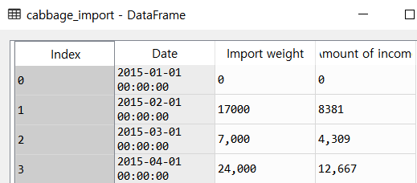
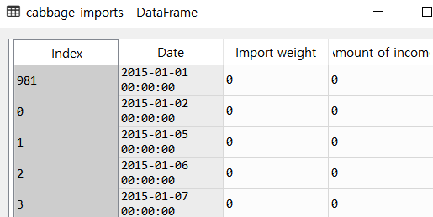
4. Make ‘Days’ on imported cabbage data

Slide 13

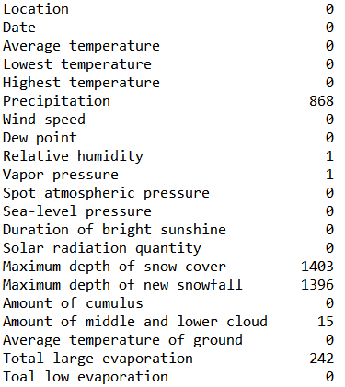
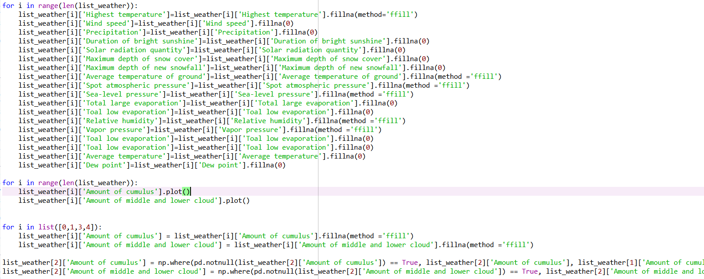
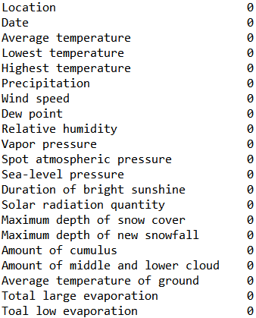
5. Fill the missing value of weather data

Slide 14
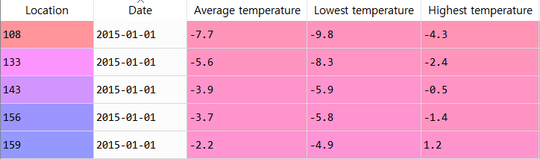

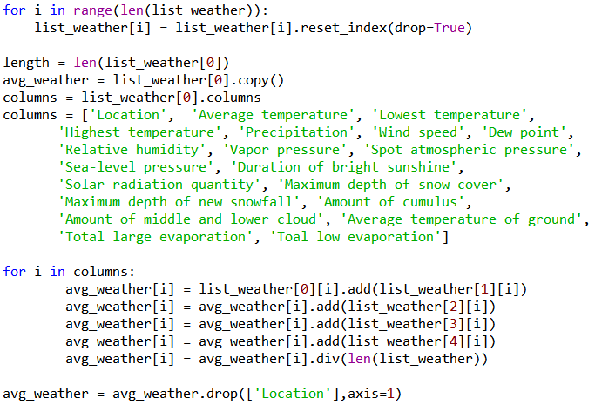
6. Make average weather data

Slide 15


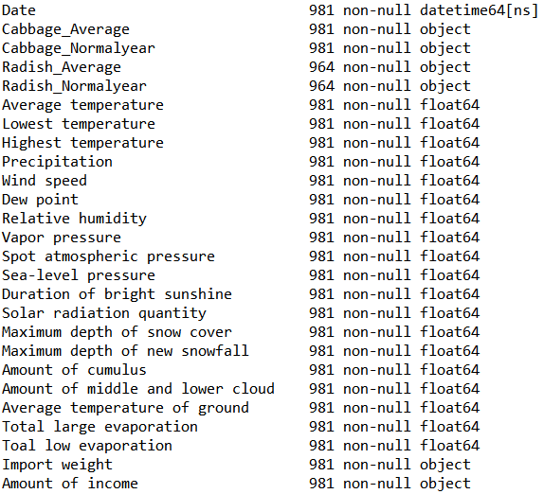
7. Merge whole data

Slide 16
3. Further Progress

Slide 17
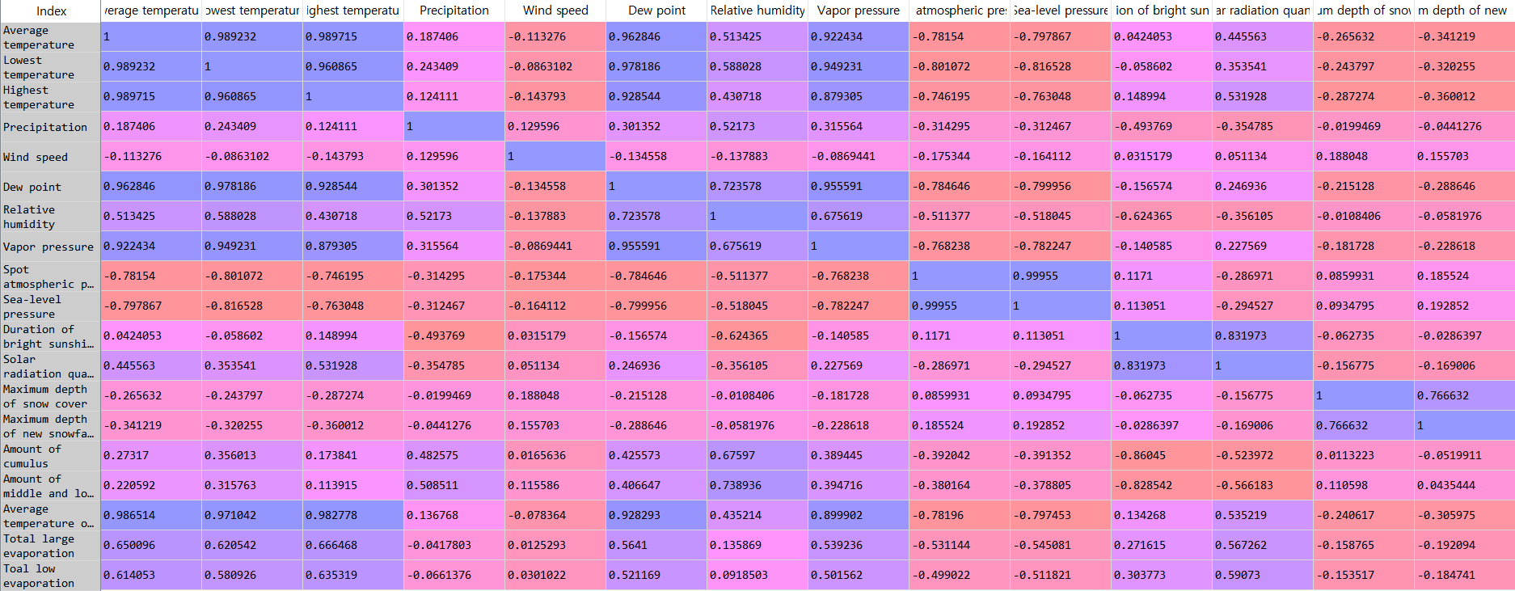

?

Slide 18
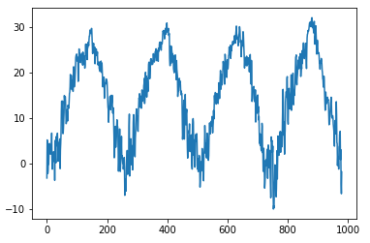
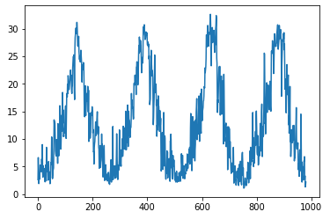
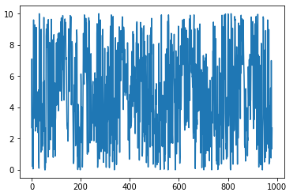
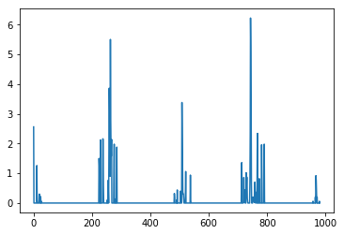
?

Slide 19
Thank you

